Slide 1

Rembrandt Painting Robot
By,
Gnana Arockia Subha Amalraj
Igor Khimchenko
Aybars Kizilay
Rohith Raju

Slide 2
Agenda
Introduction
CONSENS Models
Environment Diagram
Requirements Diagram
Application Scenarios
Functional Diagram
Active Structure
Software Architecture
Macro Architecture
Micro Architecture
Component Diagram
Real Time Coordination Patterns
Cognitive Behaviour
Control Behaviour
Implementation

Slide 3
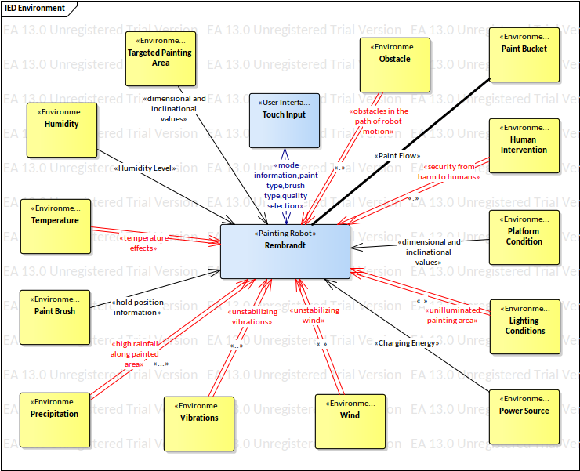
Environment Diagram

Slide 4
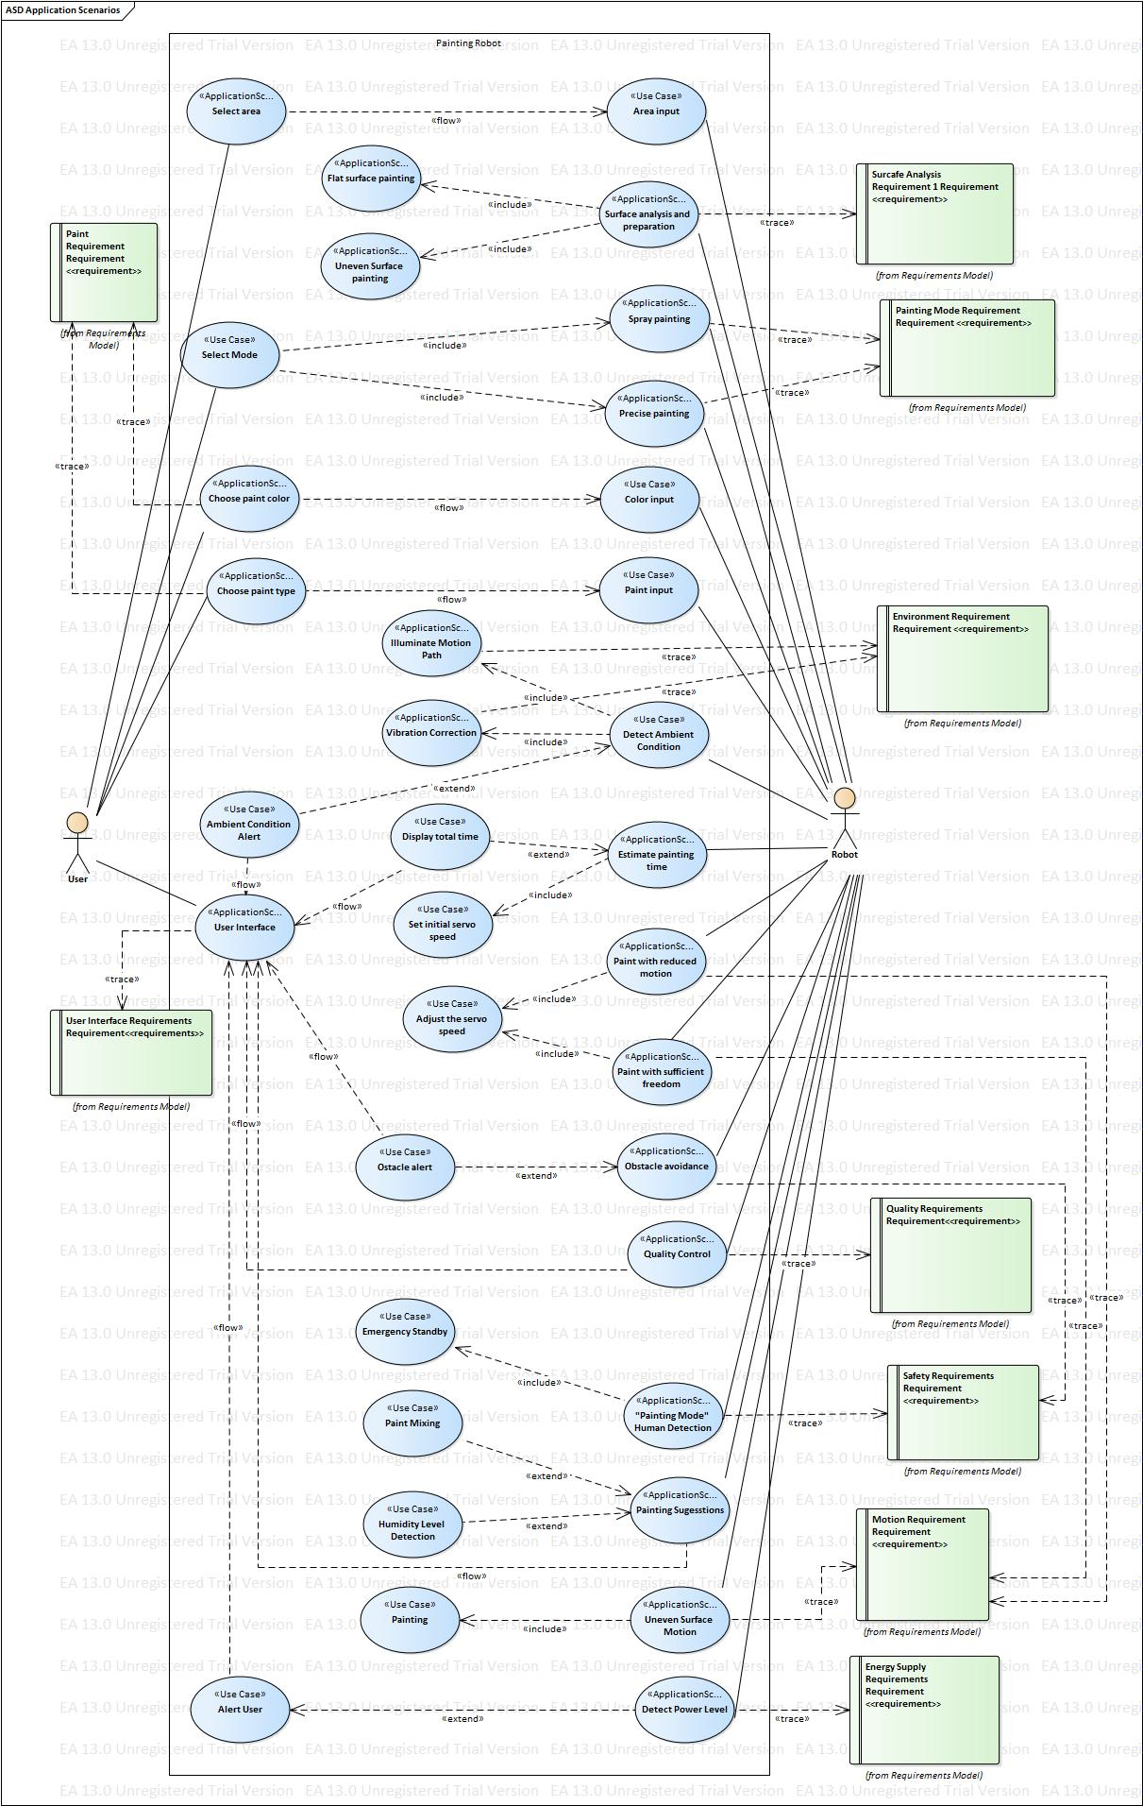
Application Scenarios

Slide 5
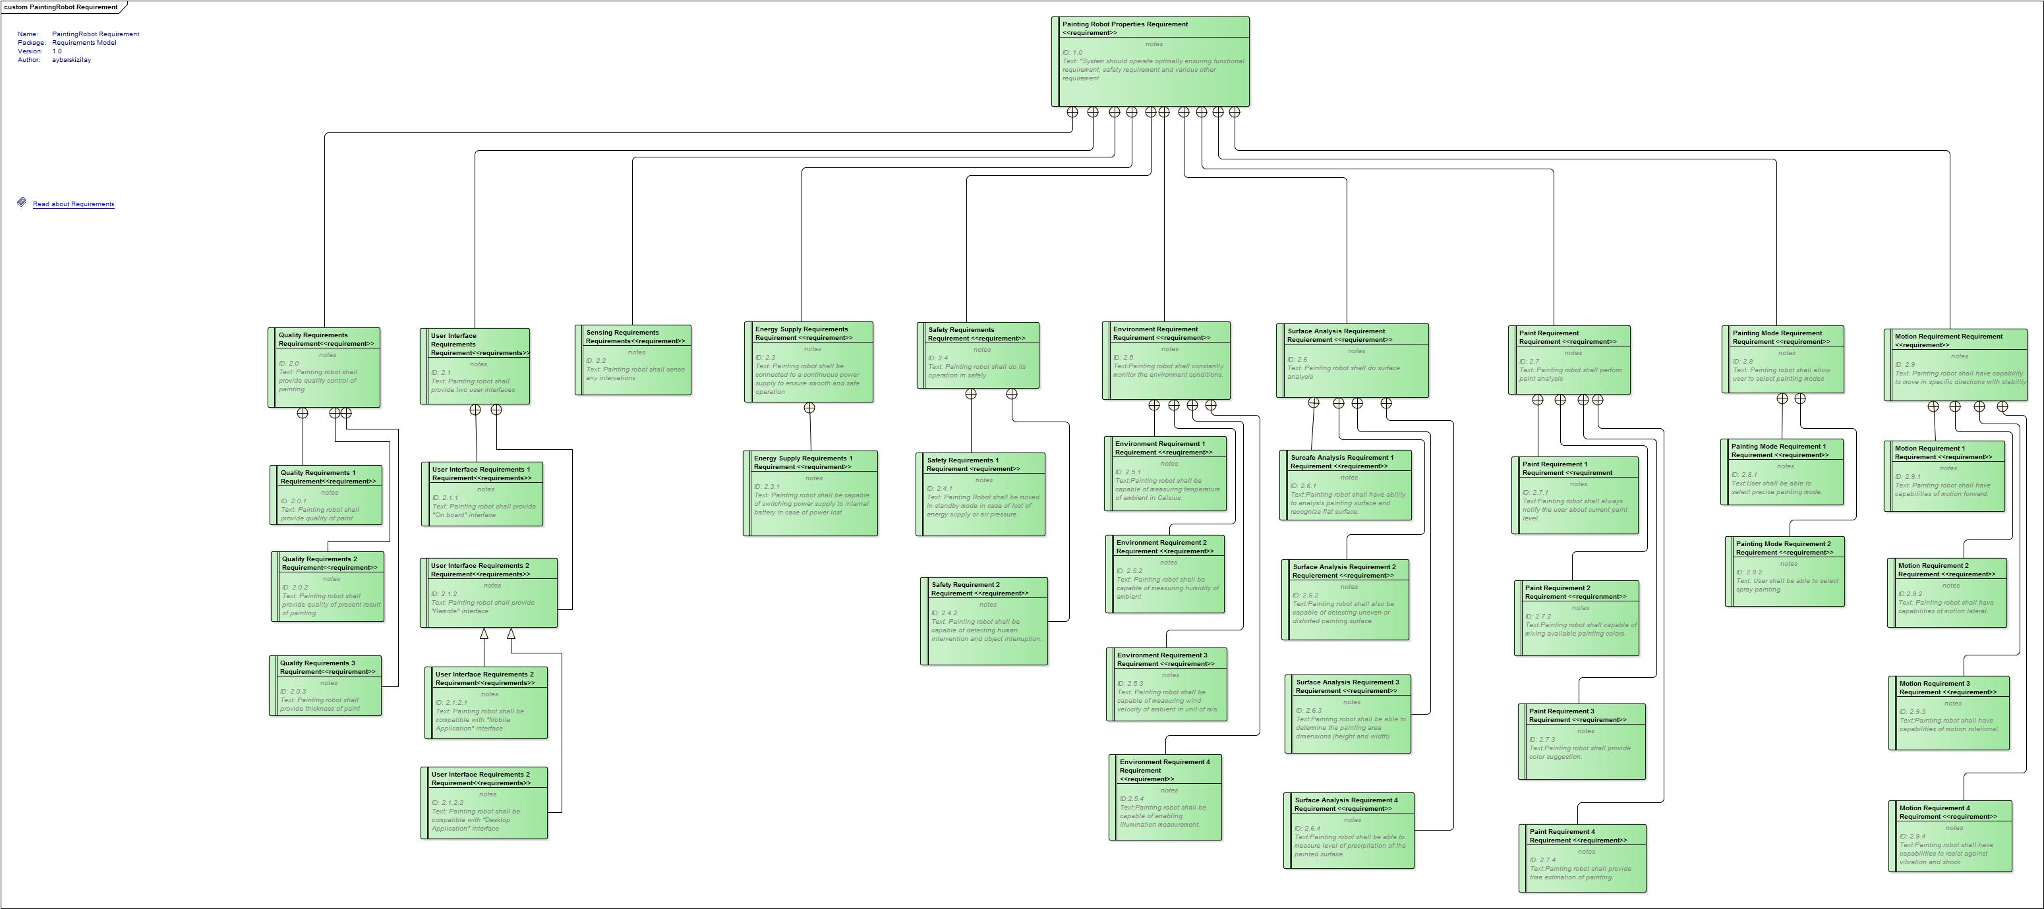
Requirements Diagram

Slide 6
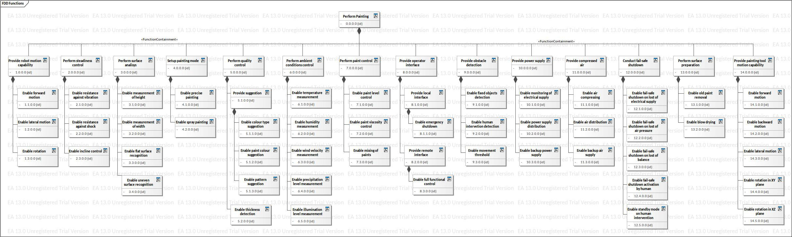
Functional Diagram

Slide 7
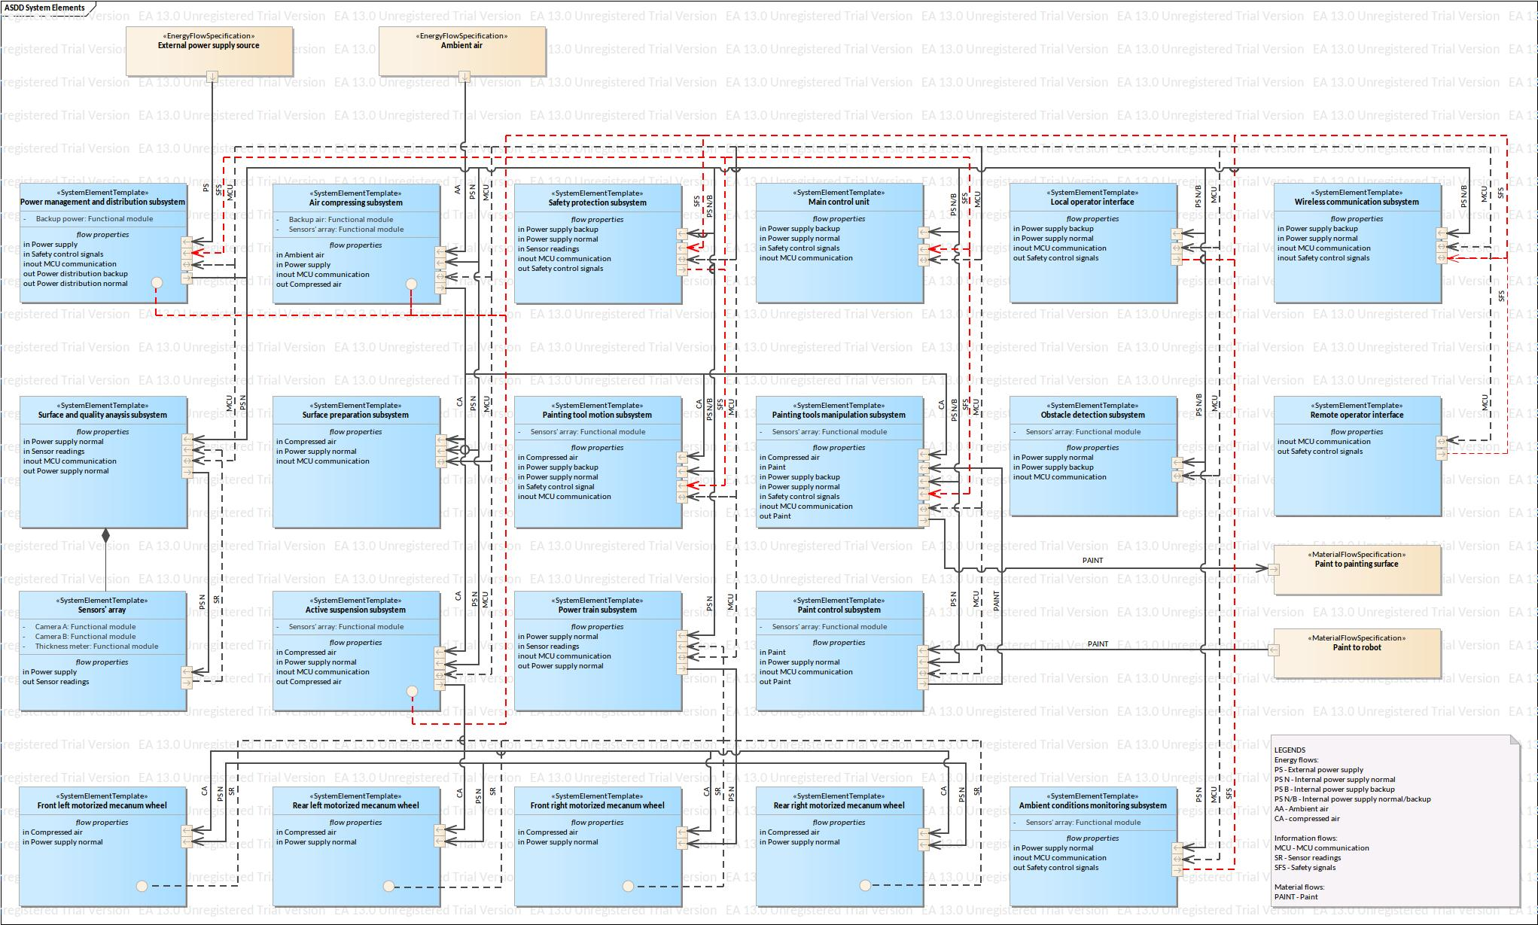
System Elements Diagram

Slide 8
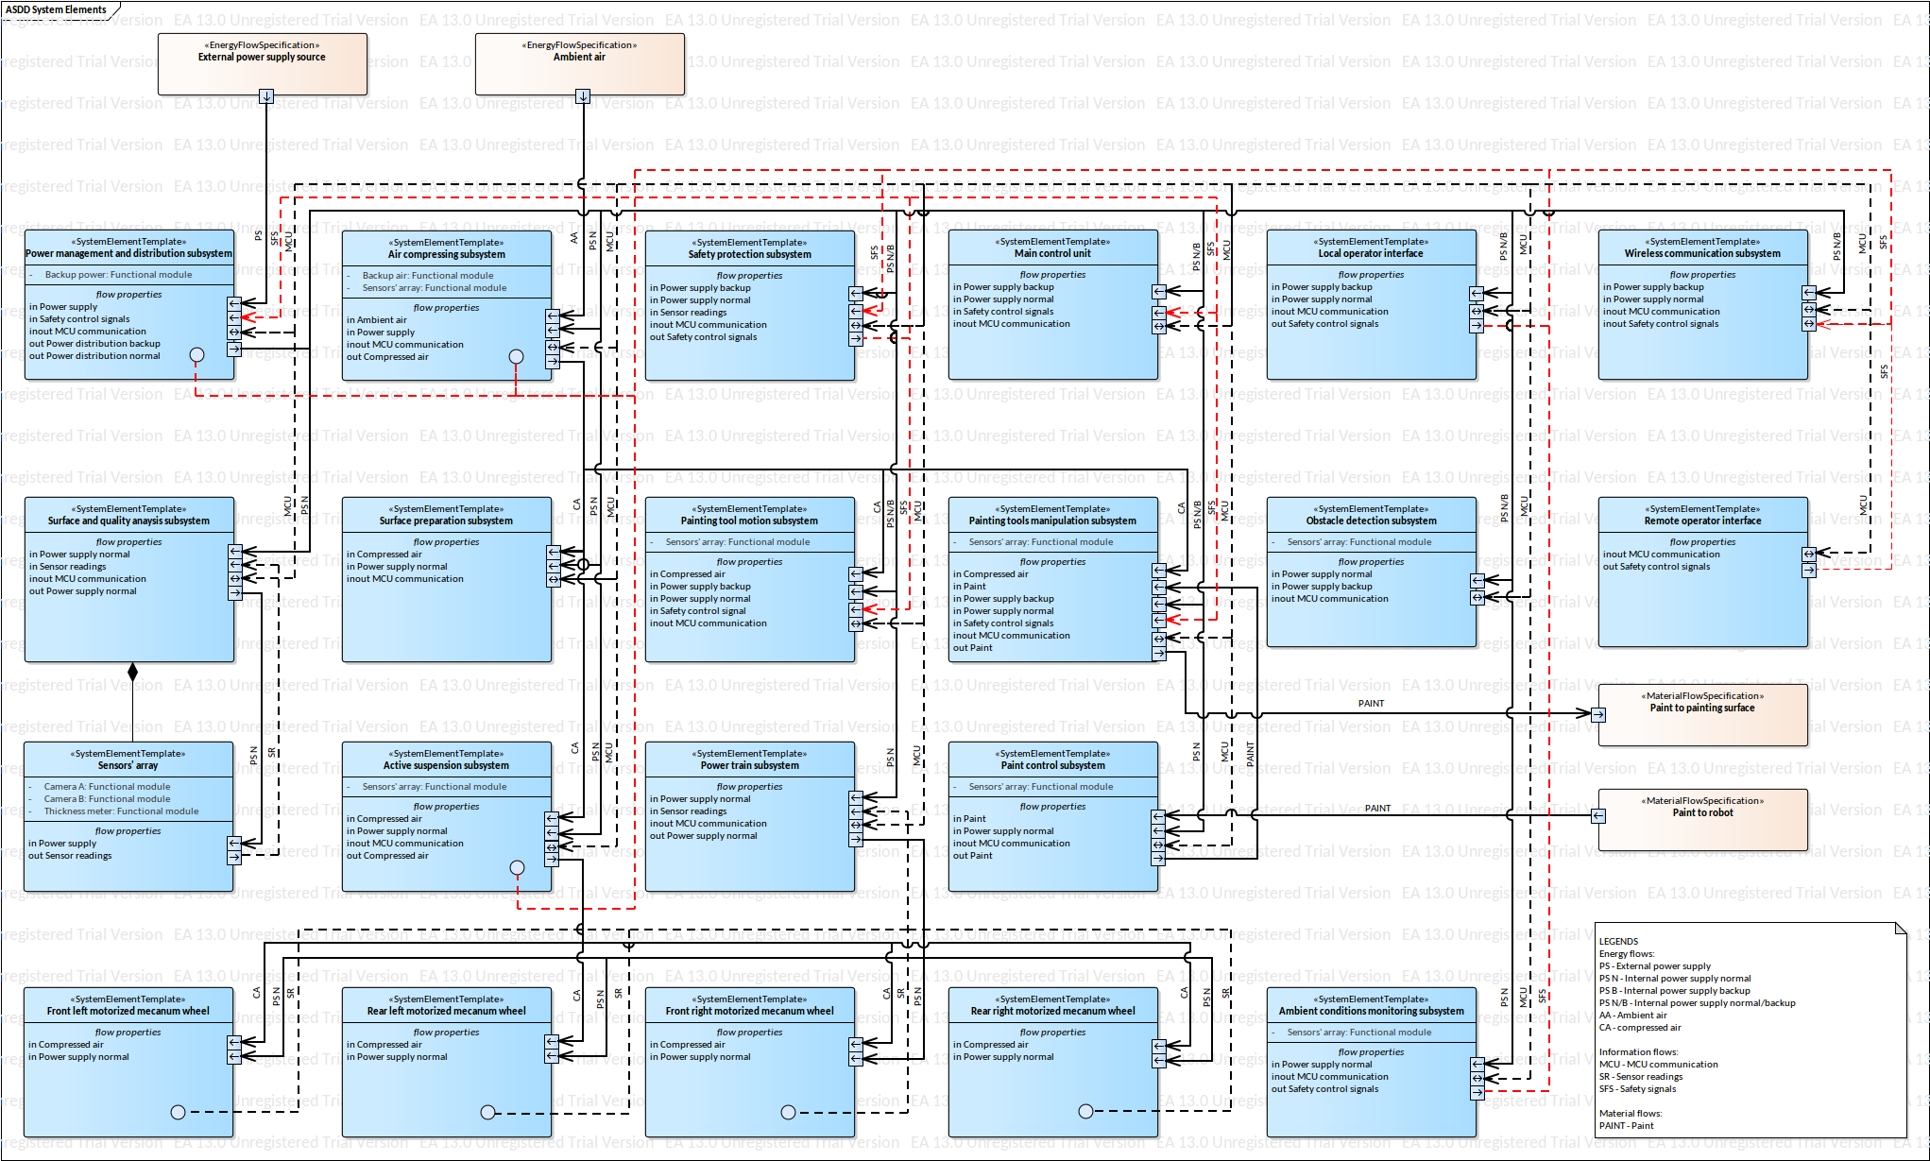
S/W Components-Mapping
Software
Electrical
Mechanical
Software Intensive

Slide 9
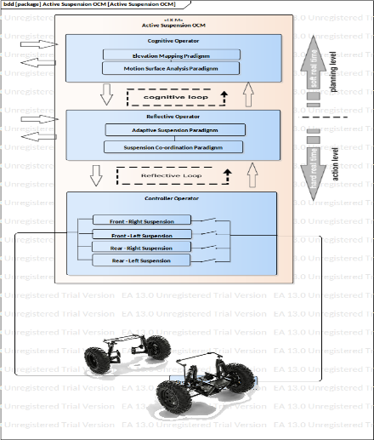
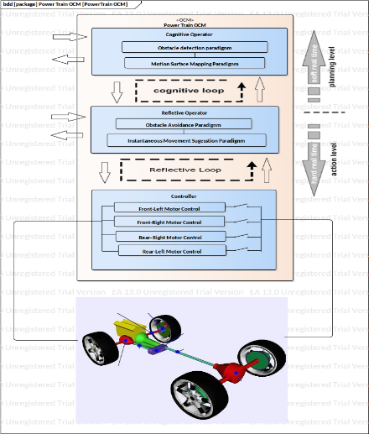
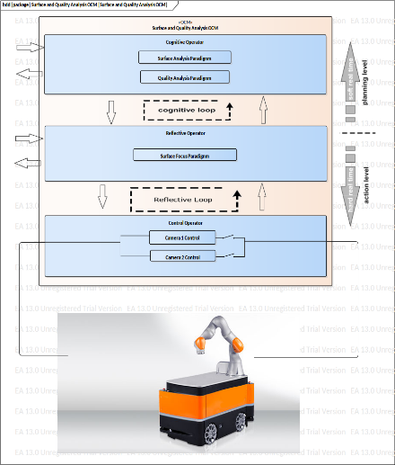
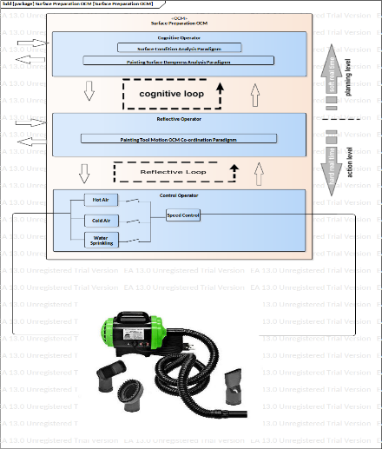
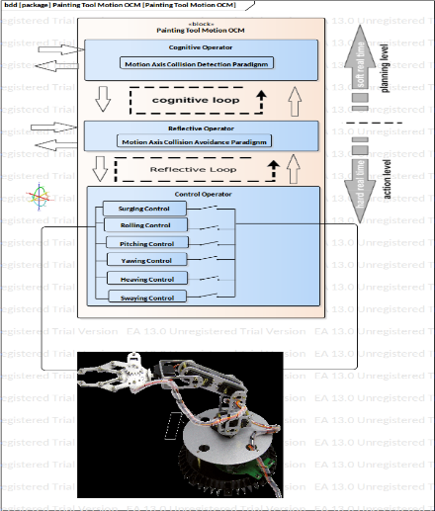
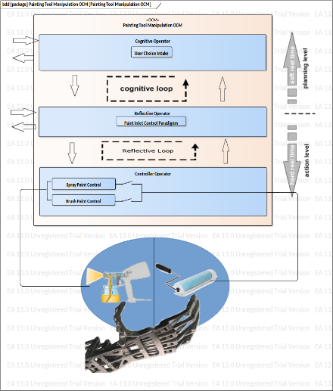
S/W Components
- Macro Architecture
Painting Robot : OCM
Active Suspension OCM
Power Train OCM
Surface and Quality Analysis OCM
Surface Preparation OCM
Painting Tool Motion OCM
Painting Tool Manipulation OCM

Slide 10

Software Components
Active Suspension
OCM

Slide 11
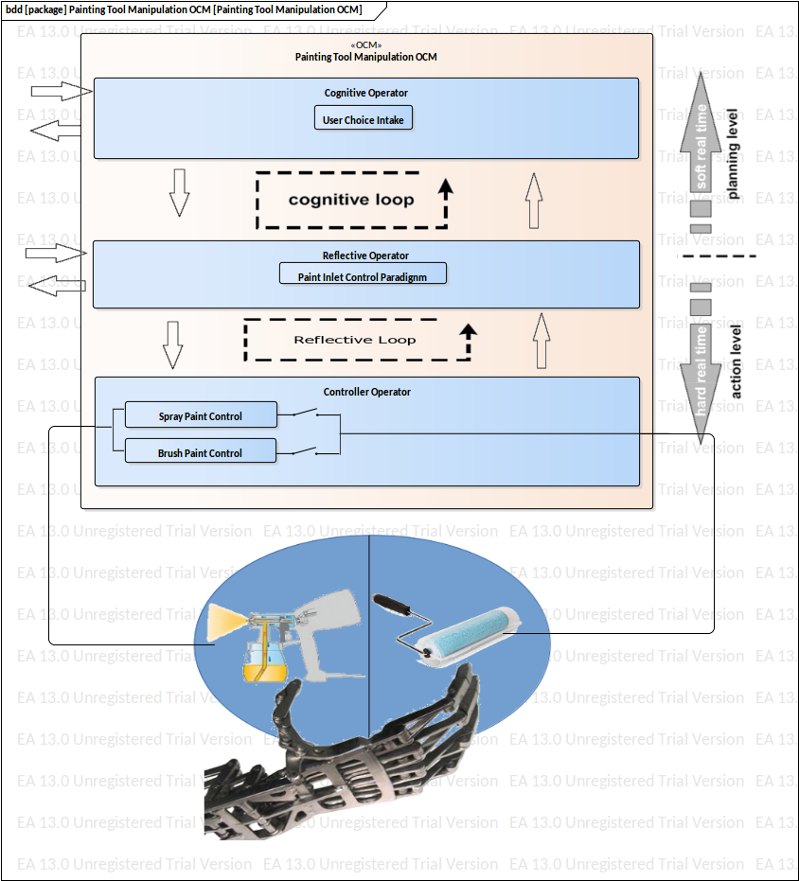
Software Components
Painting Tool
Manipulation OCM

Slide 12

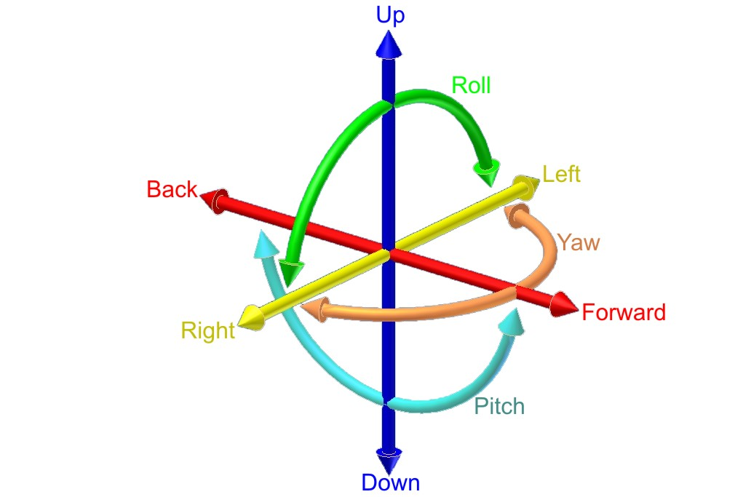
Software Components
Painting Tool
Motion OCM

Slide 13
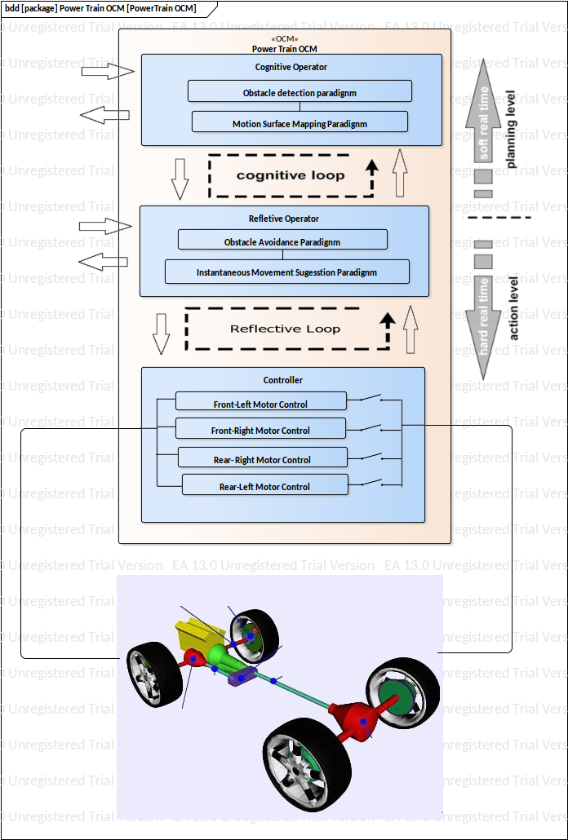
Software Components
Power Train OCM

Slide 14
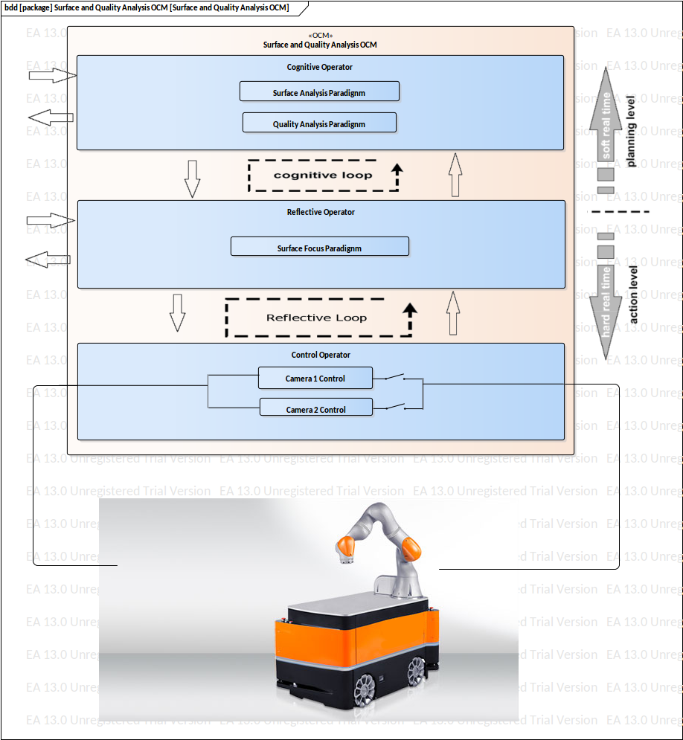
Software Components
Surface and Quality Analysis
OCM

Slide 15

Software Components
Surface Preparation
OCM

Slide 16
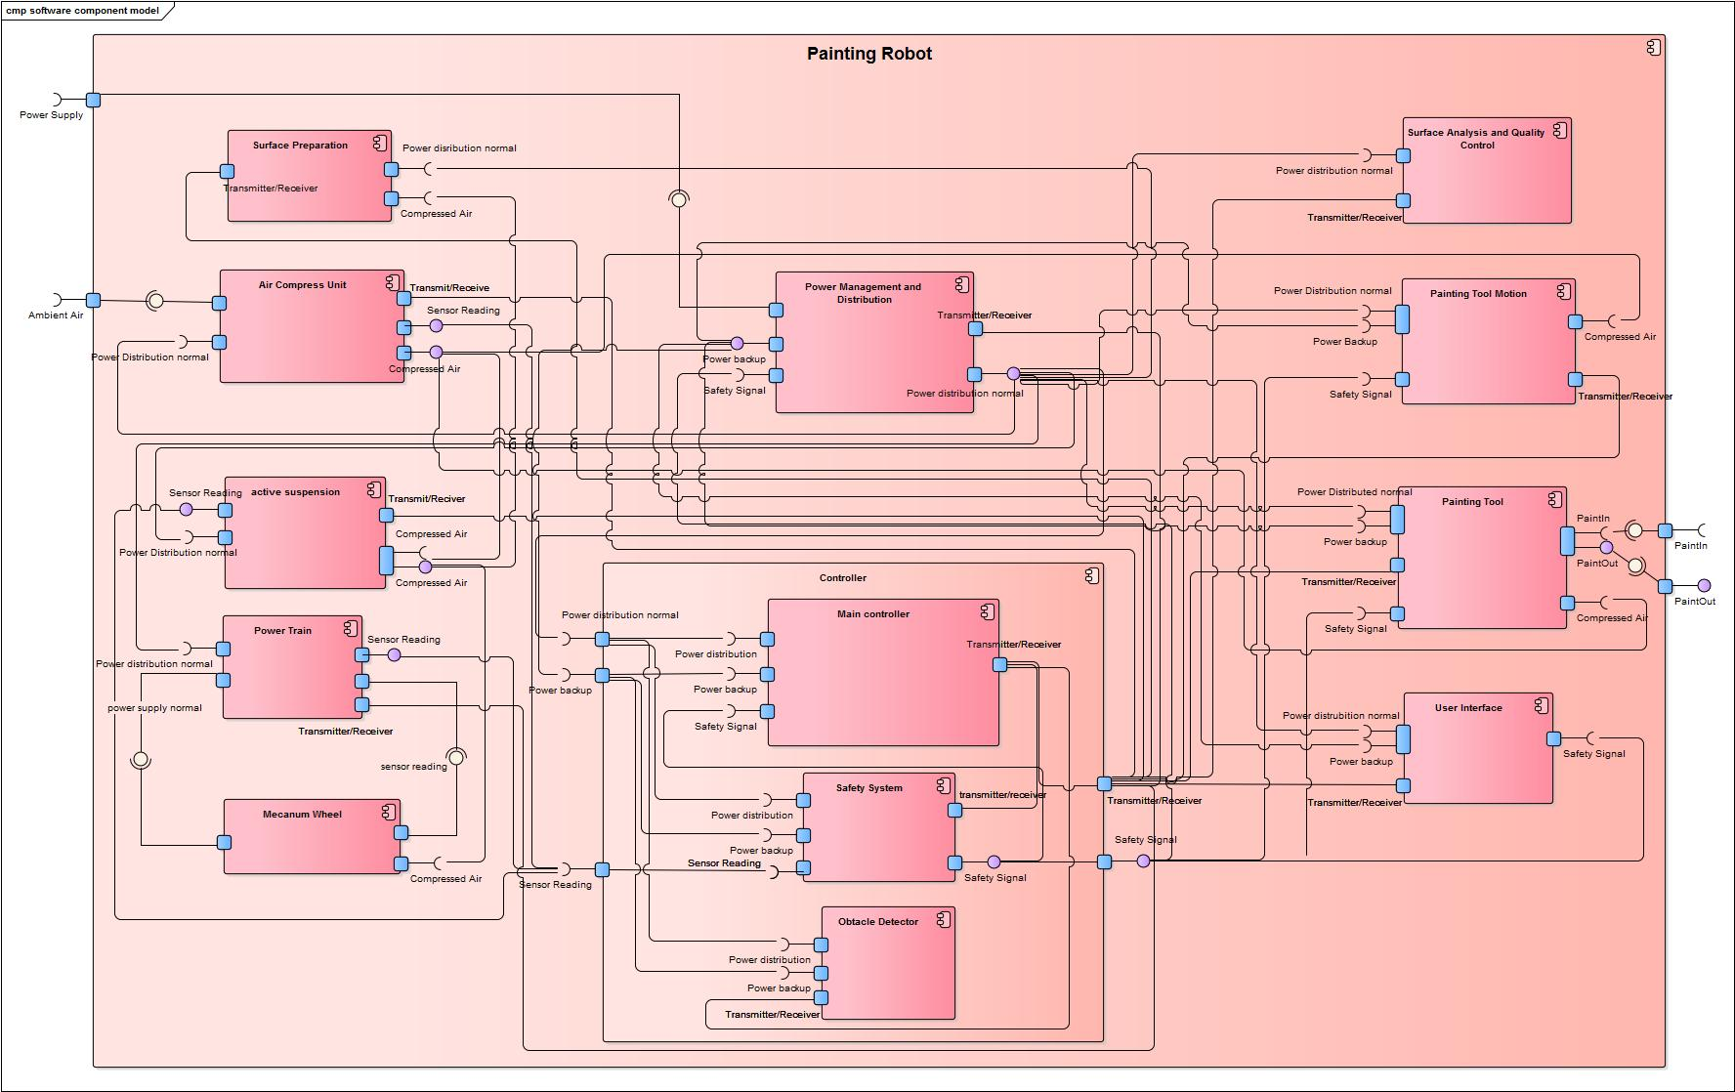
Component Diagram

Slide 17
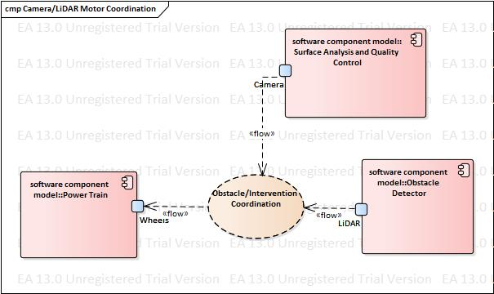
Real-Time Co-ordination

Slide 18
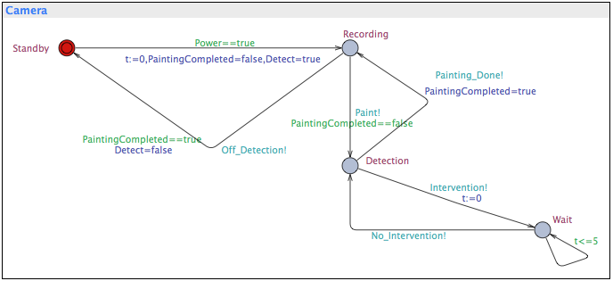
Real-Time Co-ordination

Slide 19
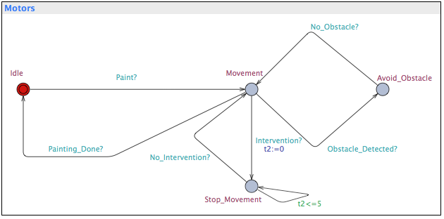
Real-Time Co-ordination

Slide 20
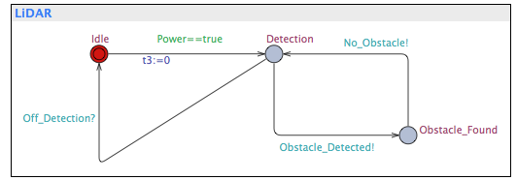
Real-Time Co-ordination

Slide 21
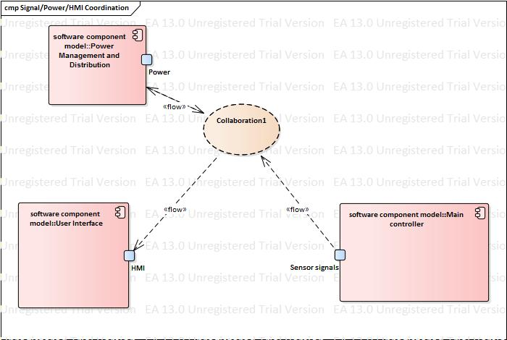
Real-Time Co-ordination 2

Slide 22
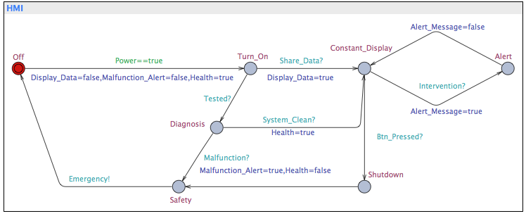
Real-Time Co-ordination 2

Slide 23
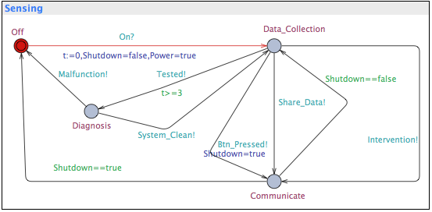
Real-Time Co-ordination 2

Slide 24
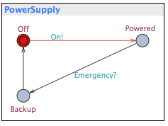
Real-Time Co-ordination 2

Slide 25
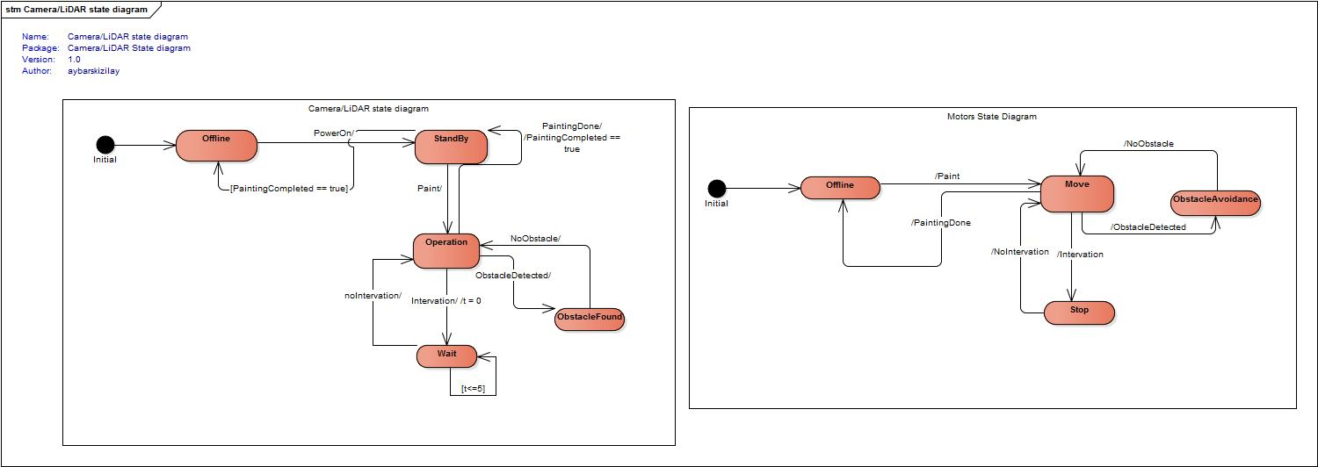
Behavioral State Diagram

Slide 26
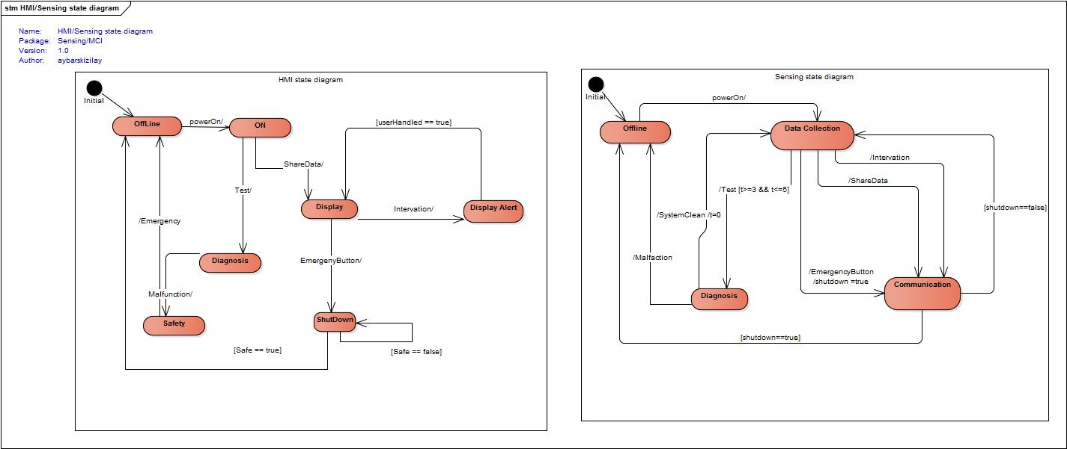
Behavioral State Diagram

Slide 27
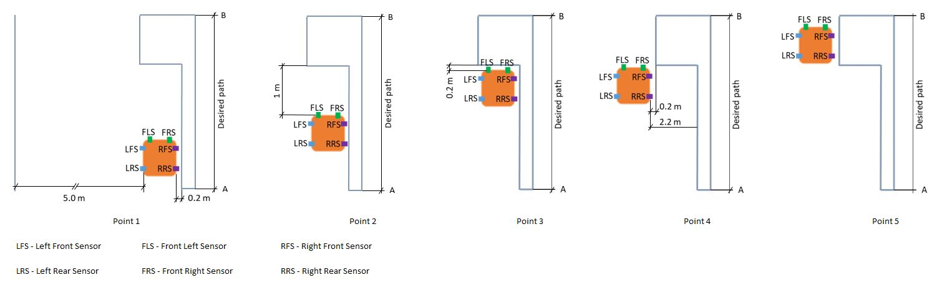
Cognitive Operator

Slide 28
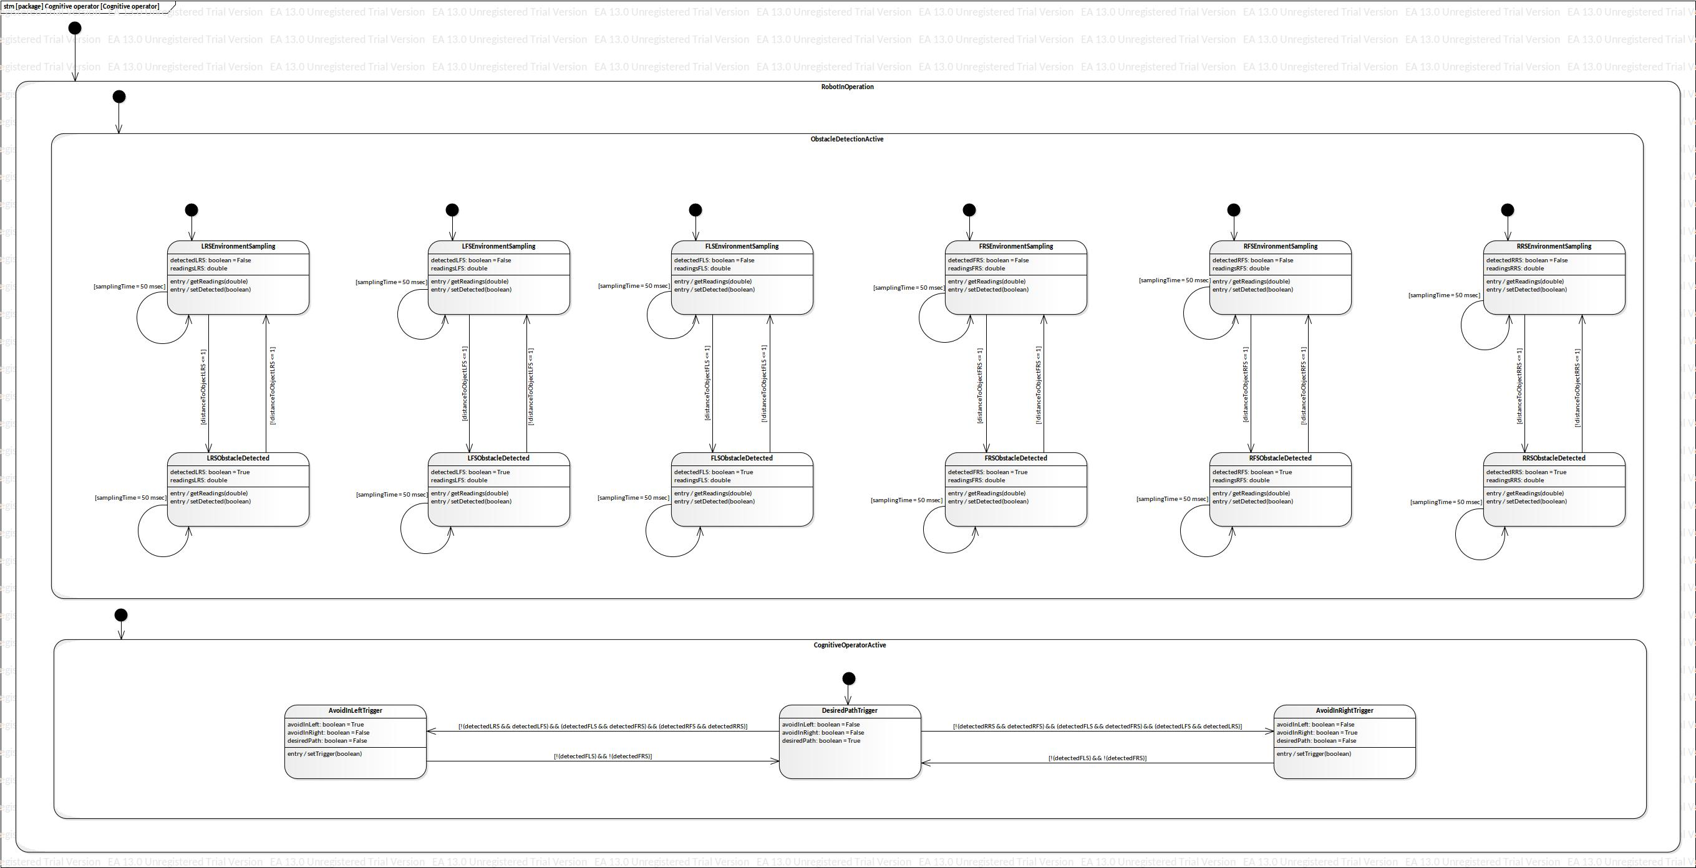
Cognitive Operator

Slide 29
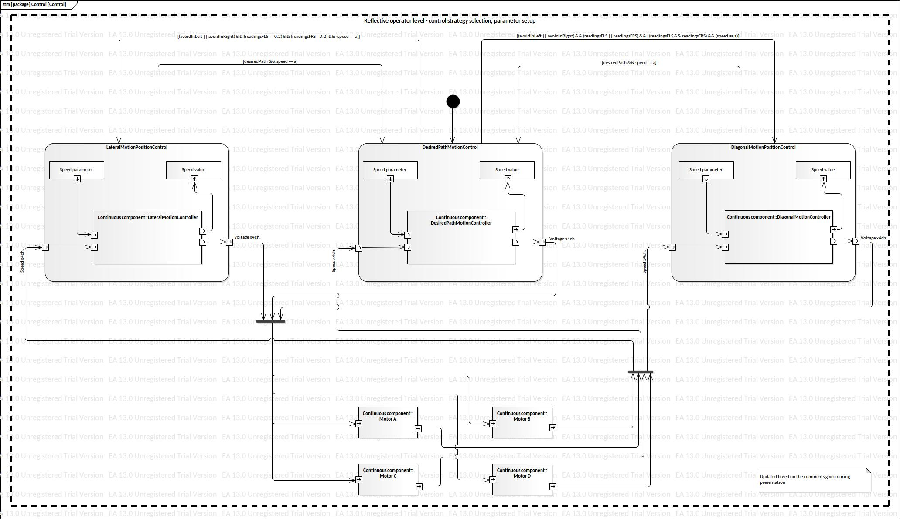
Control Operator

Slide 30
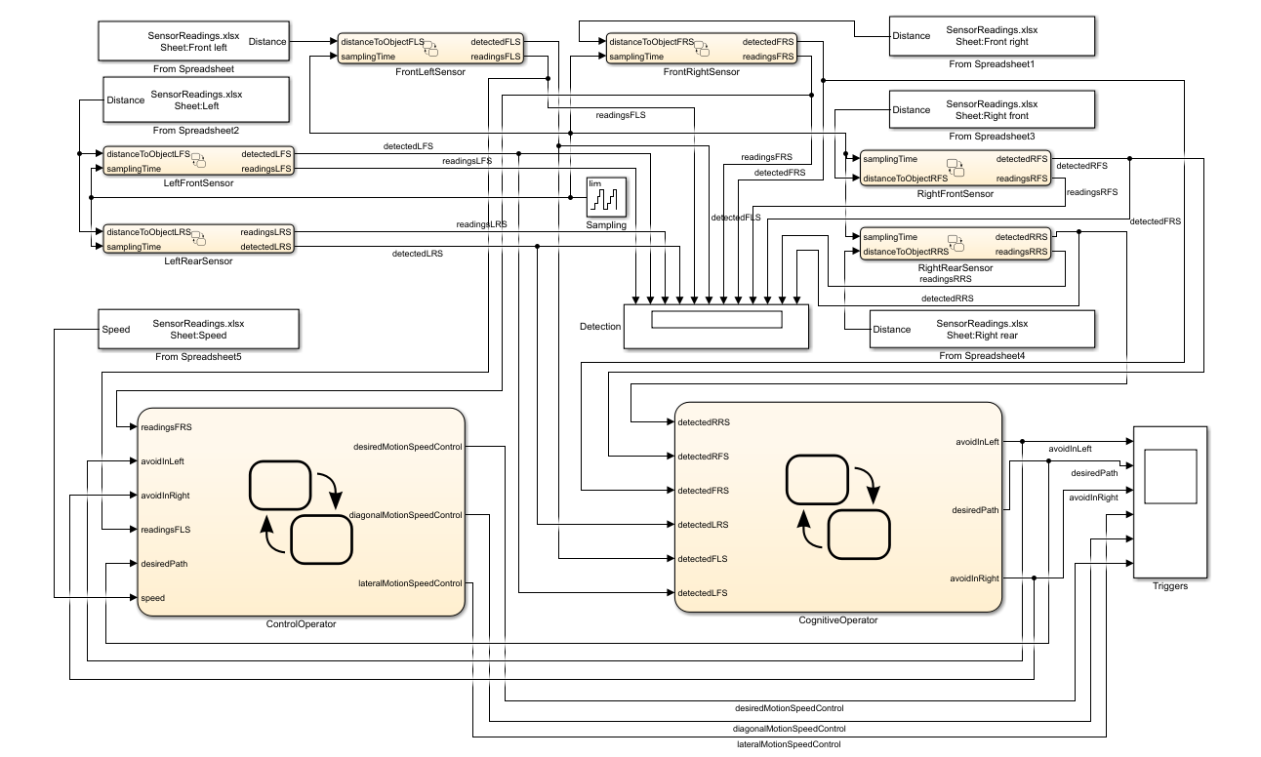
Implementation

Slide 31
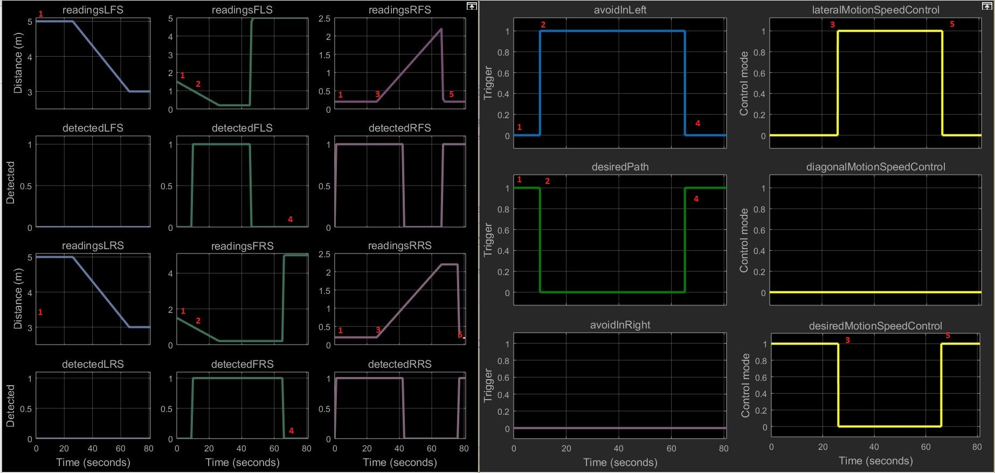
Implementation

Slide 32
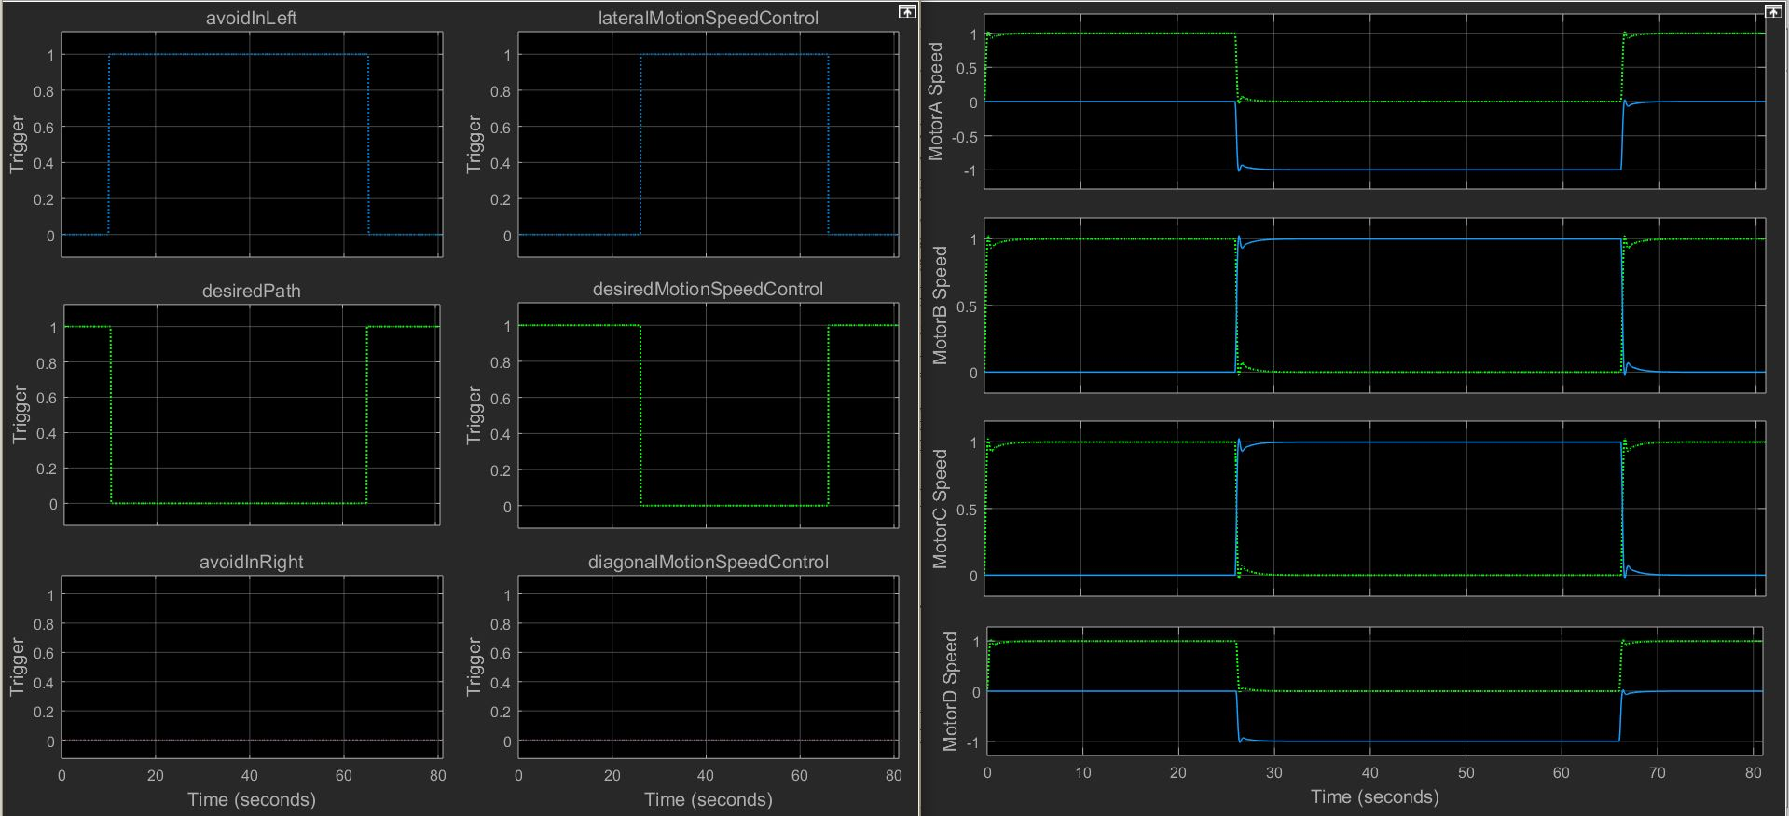
Implementation

Slide 33
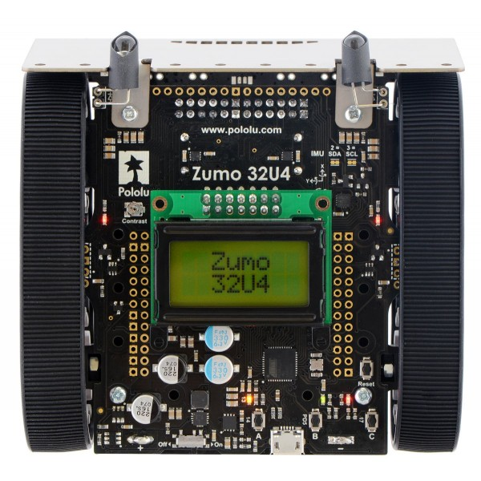
H/W Implementation

Slide 34
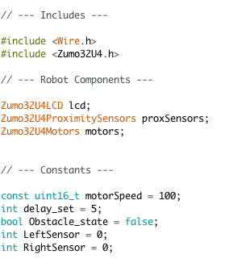
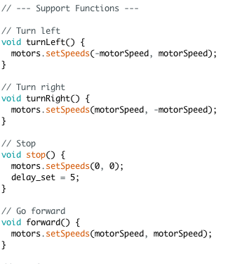
H/W Implementation

Slide 35
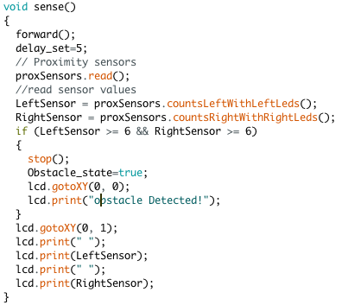
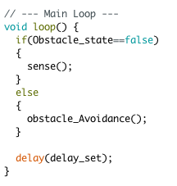
H/W Implementation

Slide 36
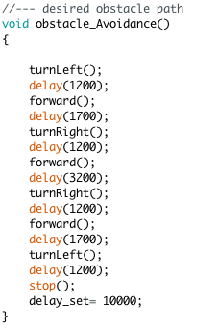
H/W Implementation

Slide 37
THANK YOU

